Slide 1

Stock Market Analysis and Future Stock Price Prediction
Using Data Analysis, Machine Learning, and Power BI
Presented by: Soham Parsodkar
Date: 30-09-2024

Slide 2

Project Overview
1
Data-Driven Project
2
Live Stock Data
3
MySQL Integration
Analyze stock market trends and predict future stock prices.
Utilizes live stock data, machine learning algorithms, and data visualization tools like Power BI.
Integration of MySQL for data storage and retrieval.

Slide 3





Project Objectives
Data Acquisition
Fetch real-time stock data from an API (Alpha Vantage).
Data Analysis
Clean, process, and analyze historical stock data.
Price Prediction
Build a machine learning model to predict future stock prices.
Visualization
Present findings and predictions using Power BI.

Slide 4
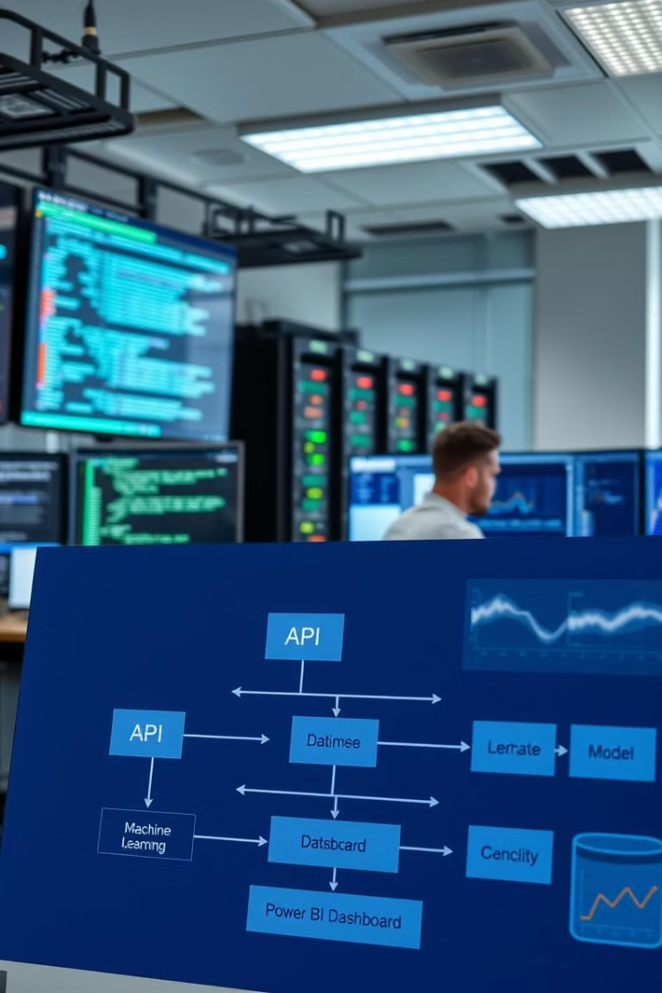




System Architecture
Data Source
API fetching real-time stock market data.
Data Storage
MySQL database for storing stock market information.
ML Model
Time-series prediction using LSTM (Long Short-Term Memory) model.
Visualization
Power BI for dashboard creation and report generation.

Slide 5
Data Acquisition Process
Source
Stored in
Tools
Real-time stock data fetched using Alpha Vantage API.
MySQL database for easy access and management.
Python for API integration and MySQL for database management.

Slide 6
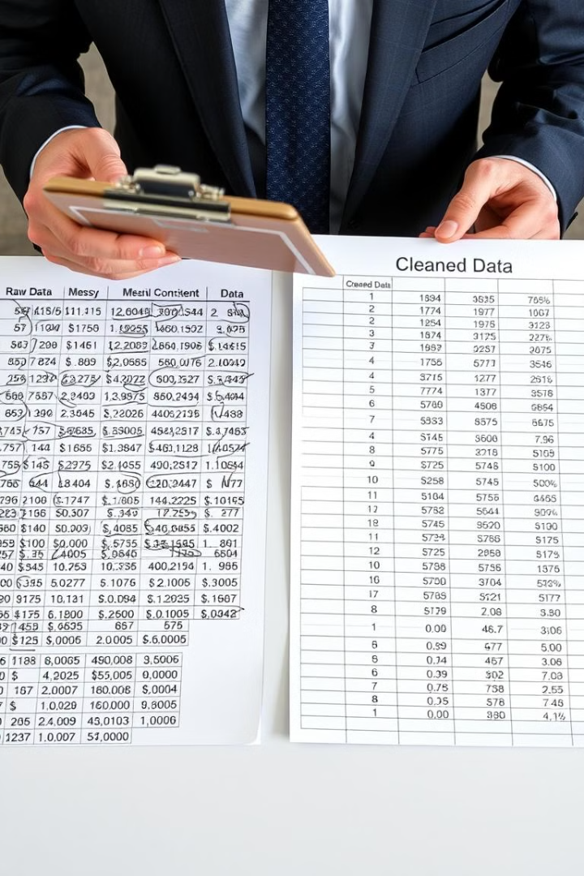
Data Cleaning and Preprocessing
Raw Data
Cleaned Data
Missing Values
Removed
Outliers
Handled
Features
Moving Averages (50-day and 200-day)
Normalization
Performed

Slide 7
Machine Learning Model for Prediction
Model Type
Purpose
Evaluation
LSTM (Long Short-Term Memory), a type of recurrent neural network (RNN) designed for time-series data.
Predict future stock prices based on historical data.
Root Mean Squared Error (RMSE) and visualization of predicted vs. actual prices.

Slide 8
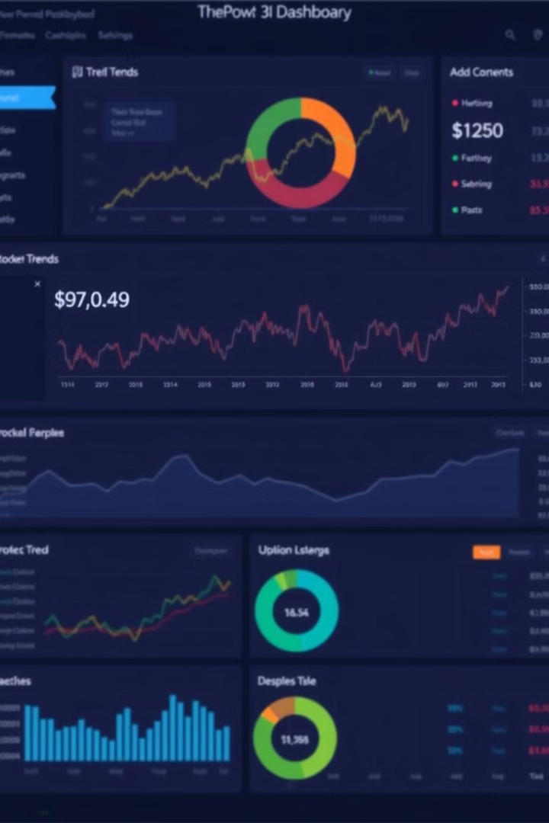
Power BI Dashboard for Visualization
Real-Time Dashboard
Displaying stock prices, moving averages, and predictions.
Custom Reports
With historical data trends and forecast results.
User-Friendly Interface
For stakeholders to visualize stock market analysis.

Slide 9
Project Timeline
Week 1-2
1
Setup and data acquisition (MySQL, API integration).
2
Week 3-5
Data cleaning and feature engineering.
Week 6-8
3
Model development and training.
4
Week 9-10
Power BI dashboard creation.
Week 11-12
5
Testing, optimization, and presentation.

Slide 10

Conclusion
1
End-to-End System
2
Impactful Results
The project aims to create an end-to-end stock price prediction system.
Combines data acquisition, machine learning, and business intelligence for impactful results.
3
Power BI Enhancement
4
Informed Decisions
Power BI enhances the visualization for stakeholders.
Provides a potential solution for traders to make informed decisions.

